Slide 1
MINOR PROJECT PRESENTATION
Stock Price Prediction Using LSTM
DRIVING SUCCESS WITH STRATEGIC DIGITAL MARKETING
PRESENTED BY:
Rajdeep Thakur (2206113)
Sumandeep Sahoo (2206302)
Anshuman Ghosh (2206074)
Debdip Chatterjee (2206087)
Tathagato Bhattacharjee (2206145)
Smruti Ranjan Rout (2206131)
Under the Guidance of
Mr. Prasenjit Maiti

Slide 2

Goal
PREDICT WHETHER A STOCK'S CLOSING PRICE WILL INCREASE OR DECREASE BASED ON HISTORICAL DATA.
Challenges:
High market fluctuations
Complex dependencies between different stock attributes
Noisy and incomplete data

Slide 3

What is the Stock Market?
Stock market prediction is a challenging task due to market volatility and numerous influencing factors.
Traditional methods struggle with non-linearity, making deep learning-based approaches more effective.
We use Long Short-Term Memory (LSTM) networks, a type of recurrent neural network (RNN), to analyze past trends and predict stock movement.

Slide 4
Technology Stack & Functionalities
FRONTEND
React.js – Dynamic & interactive UI
Recharts & Heatmaps – Data visualization for trends, volume, accuracy, and correlations
BACKEND
Flask – REST API for ML model integration
Data Processing – Handles predictions & stock market data
MACHINE LEARNING
LSTM Model (lstm_model.h5) – Predicts stock trends
Performance Metrics – R square correlation heatmaps, confusion matrix

Slide 5

Objectives
FETCH REAL-TIME STOCK DATA USING YAHOO FINANCE (YFINANCE).
COMPUTE TECHNICAL INDICATORS LIKE EXPONENTIAL MOVING AVERAGE (EMA) AND PARABOLIC SAR (PSAR).
TRAIN AN LSTM-BASED MODEL TO CLASSIFY STOCK PRICE MOVEMENTS.
EVALUATE PERFORMANCE USING R SQUARE AND CONFUSION MATRIX.

Slide 6


Methodology
Data Collection: Extract historical stock data (Open, High, Low, Close, Volume).
Feature Engineering: Compute EMA, PSAR, Trend, and Return percentage.
Preprocessing: Normalize data and create time-series sequences.
Model Training: Train LSTM with historical data to detect trends.
Evaluation: Measure accuracy and compare with actual trends.

Slide 7
Data Collection
SOURCE
TIME PERIOD
ATTRIBUTES
Stock market data is extracted using the Yahoo Finance API, providing historical and real-time stock prices for various companies with accurate financial metrics.
The dataset includes five years of stock market data, ensuring a comprehensive view of price fluctuations, trends, and market behaviors over a long duration.
Collected attributes include Open, Close, High, Low prices, Volume, and Date, which help in analyzing market trends, volatility, and predicting future stock price movements.

Slide 8

Technical Indicators
Exponential Moving Average (EMA): Smooths price data to identify trends.
Parabolic SAR (PSAR): Determines the potential reversal of price direction.
Trend Calculation: Difference between Open price and EMA.
Return Calculation: Percentage change in closing price over time.

Slide 9
Data Preprocessing
Handling missing values using forward-fill and backward-fill methods.
Feature normalization using StandardScaler.
Creating sequences of past 10 days to predict the next day's trend.
Splitting data into 80% training, 20% validation.

Slide 10
LSTM Model Architecture
Layer 1: LSTM (50 units, return sequences)
Dropout (20%)
Layer 2: LSTM (30 units)
Dropout (20%)
Dense Layer: Fully connected output layer with a sigmoid activation function.
Optimizer: Adam with a learning rate of 0.001

Slide 11
Training & Results
Loss Function: Binary Cross-Entropy
Early Stopping: Stops training if validation loss doesn’t improve
Training Metrics:
R square: 0.75 - 0.85

Slide 12
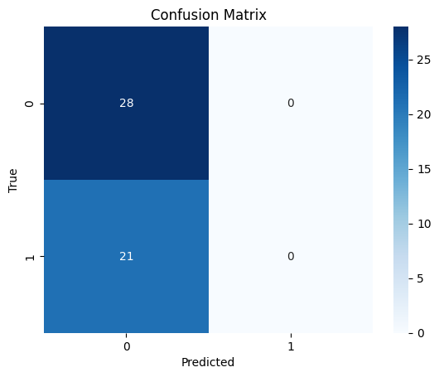
Performance Evaluation
Confusion Matrix: Visual representation of correct and incorrect predictions.
R square: 0.75 - 0.85
Limitations:
Performance depends on the timeframe and stock volatility.
External factors like news, economy, politics are not considered.

Slide 13

Visualization
Volume Over Time: Displays trading volume trends using a bar chart.
Trend Over Time: Line graph showcasing trend movements over time.
Daily Return (%): Tracks daily percentage returns for performance analysis.
Feature Correlations: Heatmap showing relationships between different financial indicators.

Slide 14
Challanges Faced
DATA INCONSISTENCIES IN FINANCIAL APIS.
DIFFICULTY IN CHOOSING THE RIGHT SEQUENCE LENGTH FOR LSTM.
TRAINING TIME AND OVERFITTING RISK.
UNDERSTANDING MARKET TRENDS BEYOND NUMERICAL INDICATORS.

Slide 15
Future Scope
ENHANCING PREDICTION ACCURACY
ADVANCED MODEL ARCHITECTURES
Integrating Sentiment Analysis from news & social media.
Experimenting with Hybrid models (CNN + LSTM).
REAL-WORLD DEPLOYMENT
EXPANDING DATA SOURCES
Deploying the model in a real-time stock analysis web app.
Including global financial indicators for better insights.

Slide 16
Thank You
START YOUR INVESTMENT JOURNEY

